Slide 1
15-453
FORMAL LANGUAGES, AUTOMATA AND COMPUTABILITY
For next time: Read 2.1 & 2.2

Slide 2
MINIMIZING DFAs

Slide 3
IS THIS MINIMAL?
NO
0
1
1
1
0
1
0
0

Slide 4
IS THIS MINIMAL?
0
1
1
0

Slide 5
THEOREM
For every regular language L, there exists a unique (up to re-labeling of the states) minimal DFA M such that L = L(M)

Slide 6
NOT TRUE FOR NFAs
0
0
0
0

Slide 7
EXTENDING δ
Given DFA M = (Q, Σ, δ, q₀, F) extend δ
to δ : Q × Σ* → Q as follows:
^
^
δ(q, ε) =
q
^
δ(q, σ) =
δ(q, σ)
^
^
δ(q, w₁ …w_{k+1} ) = δ( δ(q, w₁ …w_{k} ), w_{k+1} )
A string w ∈ Σ* distinguishes states q₁ from q₂ if
^
^
δ(q₁, w) ∈ F ⇔ δ(q₂, w) ∉ F

Slide 8
q₁
1
0
0,1
1
q₀
q₂
0
0
1
q₃
ε distinguishes accept from non-accept states

Slide 9
Fix M = (Q, Σ, δ, q₀, F) and let p, q, r ∈ Q
Definition:
p is distinguishable from q iff there is a w ∈ Σ* that distinguishes p from q
p is indistinguishable from q iff p is not distinguishable from q

Slide 10
Fix M = (Q, Σ, δ, q₀, F) and let p, q, r ∈ Q
Define relation “~”:
p ~ q iff p is indistinguishable from q
p ~ q iff p is distinguishable from q
/
Proposition: “~” is an equivalence relation
p ~ p (reflexive)
p ~ q ⇒ q ~ p (symmetric)
p ~ q and q ~ r ⇒ p ~ r (transitive)
p q r
Suppose not:
w
w

Slide 11
Fix M = (Q, Σ, δ, q₀, F) and let p, q, r ∈ Q
Proposition: “~” is an equivalence relation
so “~” partitions the set of states of M into disjoint equivalence classes
[q] = { p | p ~ q }
Q
q
q₀

Slide 12
0
1
1
1
0
1
0
0

Slide 13
Algorithm MINIMIZE
Input: DFA M
Output: DFA M_{MIN} such that:
M ≡ M_{MIN}
M_{MIN} has no inaccessible states
M_{MIN} is irreducible
||
states of M_{MIN} are pairwise distinguishable
Theorem: M_{MIN} is the unique minimum

Slide 14
Theorem: M_{MIN} is the unique minimum
Must show 2 things:
Suppose M’ is a DFA equiv M, then
1. (# states in M’) ≥ (# states in M_{MIN})
2. If (# states in M’) = (# states in M_{MIN})
then M’ is isomorphic to M_{MIN}
(i.e., same up to re-labeling of states)
Idea: States of M_{MIN} will be blocks of equivalent states of M

Slide 15
Idea: States of M_{MIN} will be blocks of equivalent states of M

Slide 16
TABLE-FILLING ALGORITHM
Input: DFA M = (Q, Σ, δ, q₀, F)
Output:
(1) D_{M} = { (p,q) | p,q ∈ Q and p ~ q }
/
(2) E_{M} = { [q] | q ∈ Q }
q₀
Base Case: p accepts and q rejects ⇒ p ~ q
q₁
/
Recursion:
q_{i}
d
d
d
σ
d
p
p′
⇒
p ~ q
~
/
/
q_{n}
d
σ
q
q′
q₀
q₁
q_{i}
q_{n}

Slide 17

TABLE-FILLING ALGORITHM
Input: DFA M = (Q, Σ, δ, q₀, F)
Output:
(1) D_{M} = { (p,q) | p,q ∈ Q and p ~ q }
/
(2) E_{M} = { [q] | q ∈ Q }
IDEA!
Make best effort to find pairs of states that are distinguishable.
Pairs left over will be indistinguishable.

Slide 18
TABLE-FILLING ALGORITHM
Input: DFA M = (Q, Σ, δ, q₀, F)
Output:
(1) D_{M} = { (p,q) | p,q ∈ Q and p ~ q }
/
(2) E_{M} = { [q] | q ∈ Q }
q₀
Base Case: p accepts and q rejects ⇒ p ~ q
q₁
/
q_{i}
q_{n}
q₀
q₁
q_{i}
q_{n}

Slide 19
TABLE-FILLING ALGORITHM
Input: DFA M = (Q, Σ, δ, q₀, F)
Output:
(1) D_{M} = { (p,q) | p,q ∈ Q and p ~ q }
/
(2) E_{M} = { [q] | q ∈ Q }
q₀
Base Case: p accepts and q rejects ⇒ p ~ q
q₁
/
Recursion:
q_{i}
d
d
d
σ
d
p
p′
⇒
p ~ q
~
/
/
q_{n}
d
σ
q
q′
q₀
q₁
q_{i}
q_{n}

Slide 20
q₀
q₁
d
q₂
d
d
q₃
d
d
d
q₀
q₁
q₂
q₃
0,1
1
0
0
0
1
q₀
q₁
q₂
q₃
1

Slide 21
0
q₀
q₁
1
1
1
0
1
0
q₀
q₃
q₂
q₁
d
0
q₂
d
q₃
d
d
q₀
q₁
q₂
q₃

Slide 22
If 2 states are not distinguished by table-filling algorithm, then they are equivalent
Proof (by contradiction):
Suppose there exist states p and q that aren’t distinguished by the T-F algorithm, but p ~ q
/
Then there exists w such that:
^
^
δ(p, w) ∈ F and δ(q, w) ∉ F
(Why is |w| >0 ?)
Of all such bad pairs, let (p, q) be a pair with the smallest |w|
So, w = σw′, where σ ∈ Σ
Let p′ = δ(p,σ) and q′ = δ(q,σ)
Then (p′, q′) is also a bad pair

Slide 23
Algorithm MINIMIZE
Input: DFA M
Output: DFA M_{MIN}
(1) Remove all inaccessible states from M
(2) Apply Table-Filling algorithm to get
E_{M} = { [q] | q is an accessible state of M }
M_{MIN} = (Q_{MIN}, Σ, δ_{MIN}, q_{0 MIN}, F_{MIN})
Q_{MIN} = E_{M}, q_{0 MIN} = [q₀], F_{MIN} = { [q] | q ∈ F }
δ_{MIN}( [q],σ ) = [ δ( q,σ ) ]
Must show δ_{MIN} is well defined!

Slide 24
Algorithm MINIMIZE
Input: DFA M
Output: DFA M_{MIN}
(1) Remove all inaccessible states from M
(2) Apply Table-Filling algorithm to get
E_{M} = { [q] | q is an accessible state of M }
M_{MIN} = (Q_{MIN}, Σ, δ_{MIN}, q_{0 MIN}, F_{MIN})
Q_{MIN} = E_{M}, q_{0 MIN} = [q₀], F_{MIN} = { [q] | q ∈ F }
δ_{MIN}( [q],σ ) = [ δ( q,σ ) ]
Claim: M_{MIN} ≡ M

Slide 25
MINIMIZE
0
q₀
q₁
0
1
0
1
0
1
q₂
0
1
1

Slide 26
1
0
0,1
0
q₀
q₁
q₄
1
1
0
q₅
q₀
0
0,1
1
q₁
d
q₂
q₃
q₃
d
d
q₄
d
d
q₅
d
d
d
d
q₀
q₁
q₃
q₄
q₅

Slide 27
1
0
0,1
0
q₀
q₁
q₄
1
1
0
q₅
q₀
0
q₁
d
q₃
q₃
d
d
q₄
d
d
q₅
d
d
d
d
q₀
q₁
q₃
q₄
q₅

Slide 28
*M_{MIN} is the unique minimal DFA equivalent to M
Suppose M′≡M_{MIN}, and M′ has no inaccessible states and is irreducible
Claim: There exists a 1-1 onto correspondence (preserving transitions) between M′ and M_{MIN}
Proof: We will construct a map recursively
Base Case: q_{0 MIN} → q₀′
Recursive Step:
If p → p′
σ
σ
Then q → q′
q
q′

Slide 29
*M_{MIN} is the unique minimal DFA equivalent to M
Suppose M′≡M_{MIN}, and M′ has no inaccessible states and is irreducible
Claim: There exists a 1-1 onto correspondence (preserving transitions) between M′ and M_{MIN}

Slide 30
*M_{MIN} is the unique minimal DFA equivalent to M
Suppose M′≡M_{MIN}, and M′ has no inaccessible states and is irreducible
Claim: There exists a 1-1 onto correspondence (preserving transitions) between M′ and M_{MIN}
NB: If M is minimal, then M has no inaccessible states and is irreducible. (So claim implies * )
This Claim is also implying the converse, ie if M has no inaccessible states and is irreducible, then M is minimal.
Proof. Let M^{min} (≡ M ≡ M_{MIN}) be minimal. Then M^{min} ≡ M_{MIN}
So, by Claim, both M^{min} and M are isomorphic to M_{MIN}
NOT TRUE for NFAs !

Slide 31
*M_{MIN} is the unique minimal DFA equivalent to M
Suppose M′≡M_{MIN}, and M′ has no inaccessible states and is irreducible
Claim: There exists a 1-1 onto correspondence (preserving transitions) between M′ and M_{MIN}
Proof: We will construct a map recursively
Base Case: q_{0 MIN} → q₀′
Recursive Step:
If p → p′
σ
σ
Then q → q′
q
q′

Slide 32
Base Case: q_{0 MIN} → q₀′
Recursive Step:
If p → p′
σ
σ
Then q → q′
q
q′
We need to prove:
The map is defined everywhere
The map is well defined
The map is a bijection

Slide 33
Base Case: q_{0 MIN} → q₀′
Recursive Step:
If p → p′
σ
σ
Then q → q′
q
q′
The map is defined everywhere
That is, for all q ∈ M_{MIN} there is a q′ ∈ M′ such that q → q′
If q ∈ M_{MIN}, there is w such that δ_{MIN}(q_{0 MIN},w) = q
^
^
Let q′ = δ′(q₀′,w)

Slide 34
Base Case: q_{0 MIN} → q₀′
Recursive Step:
If p → p′
σ
σ
Then q → q′
q
q′
The map is well defined
Suppose there exist q′ and q′′ such that
q → q′ and q → q′′
We show that q′ and q′′ are indistinguishable,
so it must be that q′ = q′′

Slide 35
Suppose there exist q′ and q′′ such that
q → q′ and q → q′′
Suppose q′ and q′′ are not indistinguishable
M_{MIN}
M′
u
w
u
w
Accept
Accept
q_{0 MIN}
q
q₀′
q′
v
w
v
w
q
Reject
q₀′
q′′
Reject
q_{0 MIN}

Slide 36
Base Case: q_{0 MIN} → q₀′
Recursive Step:
If p → p′
σ
σ
Then q → q′
q
q′
The map is onto
For all q′ ∈ M′ there is a q ∈ M_{MIN} such that q → q′
If q′ ∈ M′, there is w such that δ′(q₀′,w) = q′
^
^
Let q = δ_{MIN}(q_{0 MIN},w)

Slide 37
The map is 1-1
Suppose there exist p and q such that
p → q′ and q → q′
Suppose p and q are not indistinguishable
M_{MIN}
M′
u
w
u
w
Accept
Accept
q_{0 MIN}
p
q₀′
q′
v
w
v
w
q
Reject
q₀′
q′
Reject
q_{0 MIN}

Slide 38
How do we prove two regular expressions are equivalent?

Slide 39
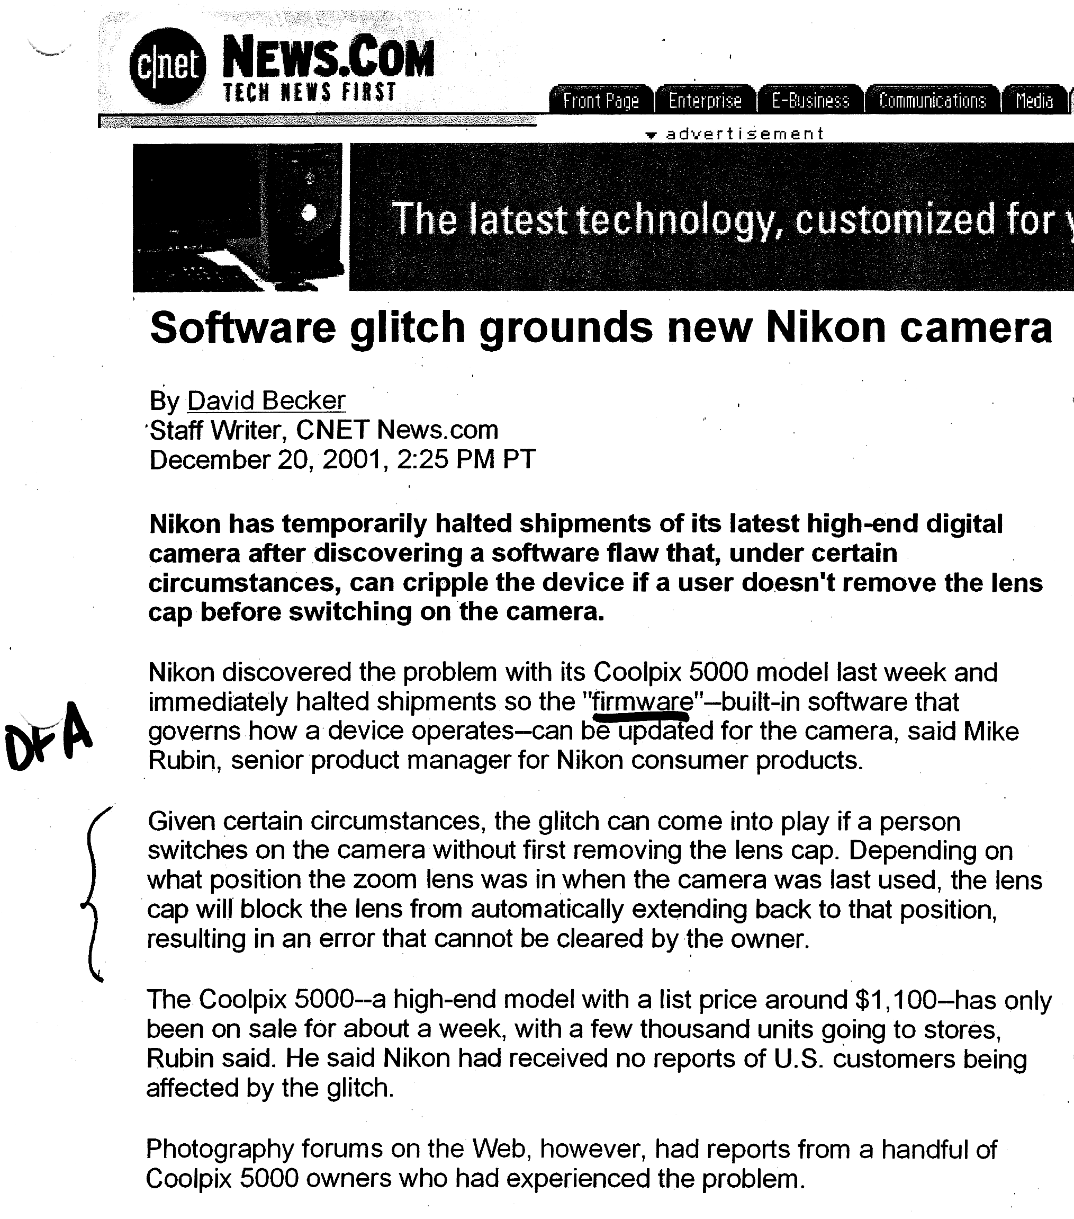

Slide 41
Finish Reviewing Chapter 1 of the book and
Read 2.1 & 2.2 for next time

